Slide 1
Case In Point
Graph Analysis for CONSULTING AND CASE INTERVIEWS - 2

Slide 2

Area Graphs - Introduction & Scan
Area graph is usually used to represent how components change over time
Area graph is similar to line graphs except in 2 ways –
The area below line is filled with color to represent volume
The area graph shows the sum of all lines unlike line graph which shows only component’s individual values
We can tell from the example(pic) on an overall level that revenues have increased from $25 to $100 in the period from 1/1/2001 to 1/1/2006
Crucial thing to understand is what is driving the significant revenue increase. We can find that by diving further

Slide 3
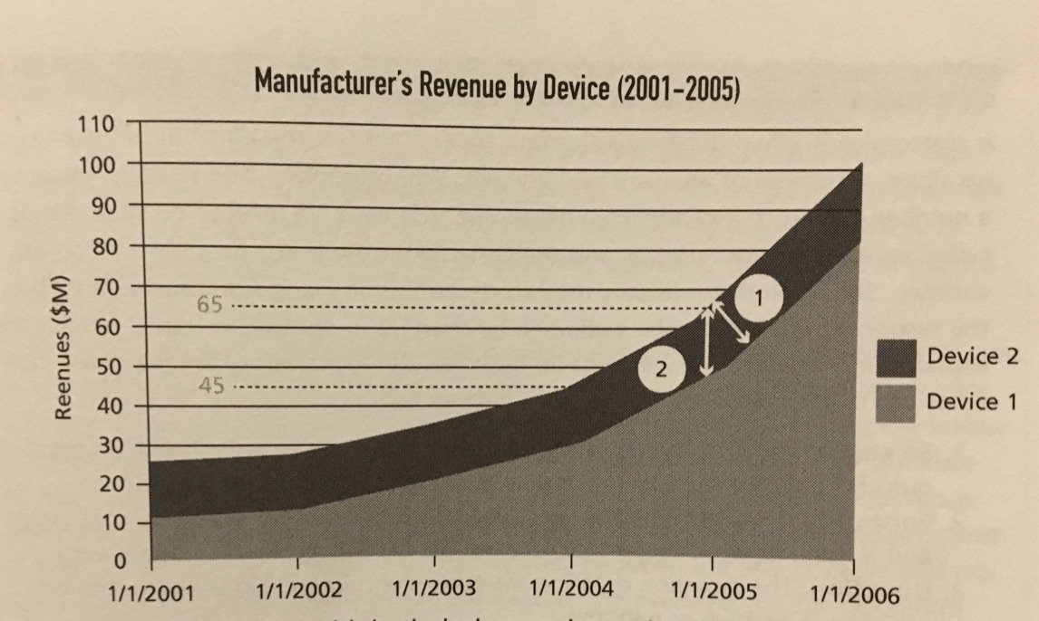
Area Graphs - Extract & Apply
Device 1’s contribution was $10M and Device 2’s contribution was $15 at 1/1/2001 as calculated by looking at the bottom and top of the component's band
The area represents the revenue in the graph. So we can easily tell that Device 1’s area has increased
It’s not very obvious for Device 2. But as portrayed in the figure the revenue is increase for Device 2 as well from $15 on 1/1/2001 to $20 on 1/1/2005
Hence, both devices are contributing to the overall revenue increase, but device 1’s are in contributing more rapidly
The application of this insight requires knowledge of our client’s business problem. With the unknows, any recommendation should be accompanied with caution

Slide 4
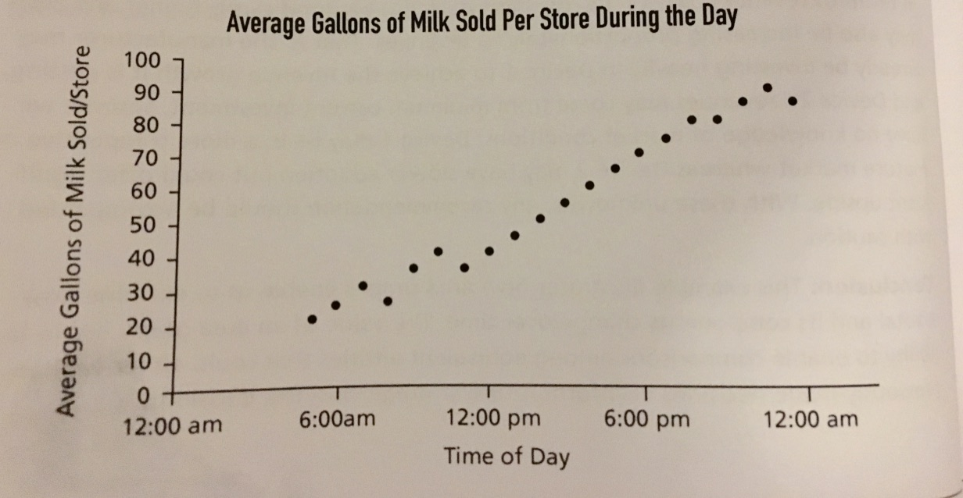
Scatterplot - Introduction
A scatterplot is a two-dimensional graph that shows the relationship between two variables
The variable plotted on the X-axis is called an explanatory variable, and the variable on the y-axis is called a response variable
The relationship between the explanatory and response variables can be defined using the following three factors:
Strength - How strong the two variables are related
Form - To check whether there is a relationship between the variables
Direction – Describes whether the relationship between the variables is positive or negative

Slide 5
Scatterplot - Scan, Extract & Apply
As we can see from the graph least number of gallons sold during the day is approximately 20 at 5 am and the most is 90 at 11 PM
For determining the relationship the best fit line is useful
The datapoints are fairly clustered and not dispersed so the relationship appears to be strong
The best fit line is linear in nature, which means both variables move together
The relationship is positive as X-value increases Y-value increases too
We can apply this insight into business and it can help us optimize inventory management
Best fit line

Slide 6
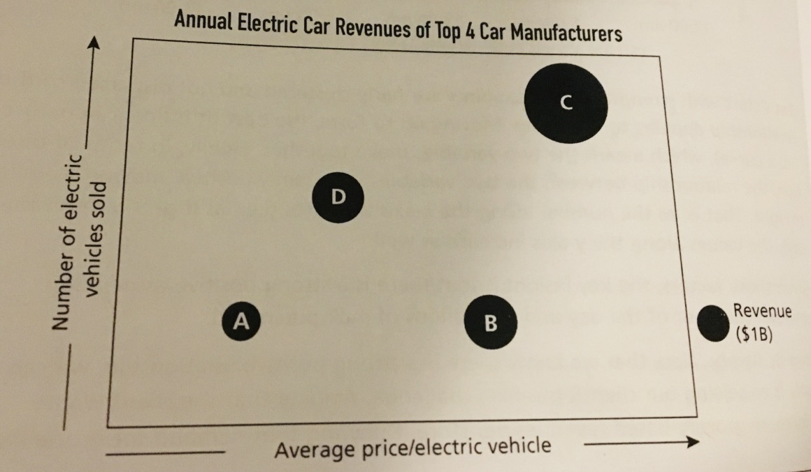
Bubble Graph
Bubble graph is a graph that consultants often use because of it’s power to represent multiple sets of data elegantly
Bubble graph unlike other graphs communicates 3 or more dimensions or variables of data
C is the largest bubble and it means it has the highest revenue hence either number of vehicles sold is higher or the revenue. But in this case both hold true
D and B have same size in other terms has the same revenue but different positioning is due to D sells more car for lesser price whereas B sells lesser car for higher price
Clearly A is the lowest revenue company and sells the least amount of cars and it is priced the least
Best fit line

